Slide 1
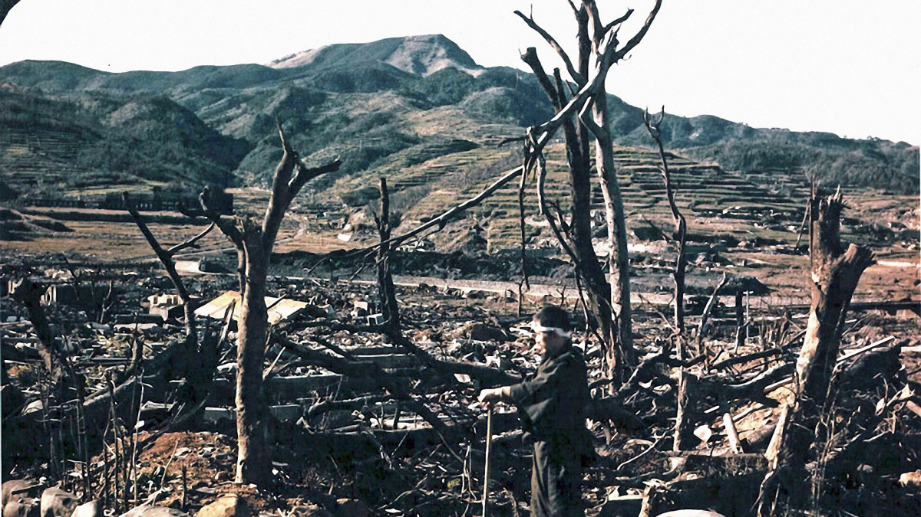
Nuclear Bombings of Hiroshima and Nagasaki
-Balu, Aashish, Selva Karthik

Slide 2

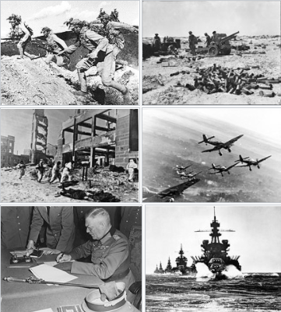
The World War II
WWII or the Second World War, one of the most destructive global wars of all time lasted from 1939 to 1945 between the Allies and the Axis Powers.
Approximately about 75 Million people have died in this war (including almost 45 nations).
In this war, the aircrafts have played a major role in this conflict, including strategic bombing in of population centers and the development of nuclear weapons have increased destruction.

Slide 3
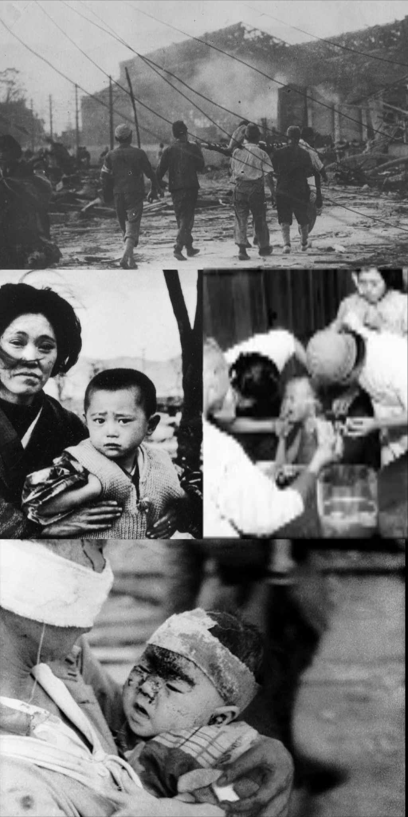
The World War II
One of the nations that has been worst affected in this war is Japan.
It is estimated between 129,000 and 226,000, most of whom were civilians, have been killed terribly in this blast.
Large numbers of people continued to die from the effects of burns, radiation sickness, and injuries, compounded by illness and malnutrition .

Slide 4
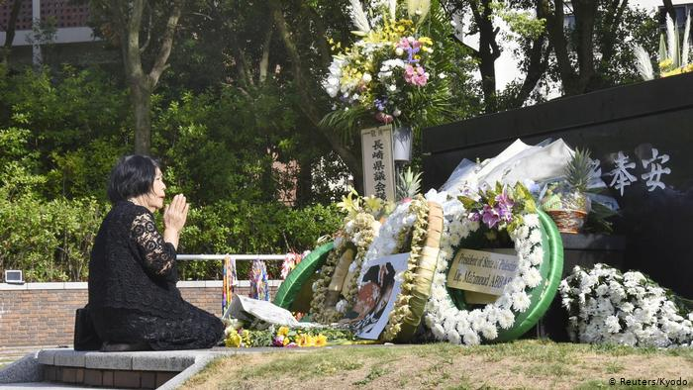
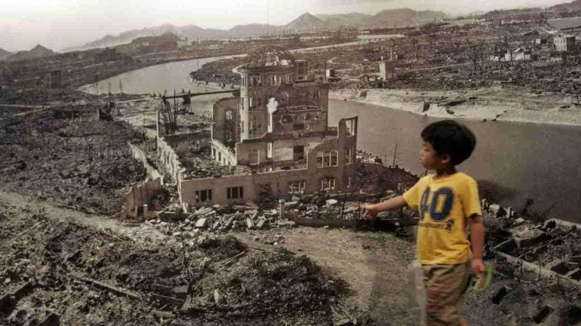
What Happened ?
On August 6, 1945, during World War II (1939-45), an American B-29 bomber dropped the world’s first deployed atomic bomb over the Japanese city of Hiroshima.
The explosion immediately killed an estimated 80,000 people. Tens of thousands of more people later died of radiation exposure.
Three days later, a second B-29 dropped another nuclear bomb on Nagasaki, killing an estimated 40,000 people.

Slide 5
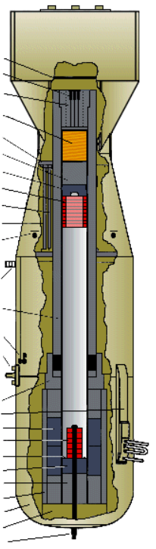
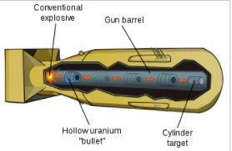
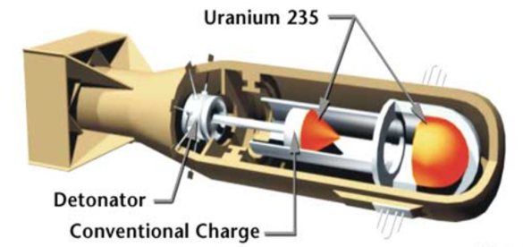
Little Boy
“Little Boy” was the Name of the Atomic Bomb dropped by America on Hiroshima.
Little Boy was developed by Lieutenant Commander Francis Birch group at the Manhattan Project's Los Alamos Laboratory during the second world war, a reworking of their unsuccessful Thin Man nuclear bomb.
Like Thin Man, it was a gun-type fission weapon, but it derived its explosive power from the nuclear fission of uranium-235, whereas Thin Man was based on fission of plutonium-239.

Slide 6
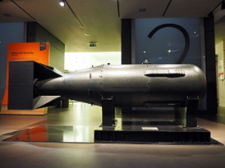
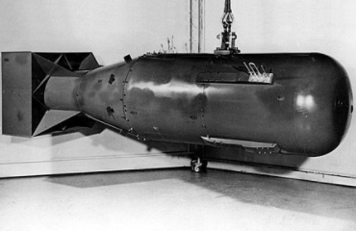
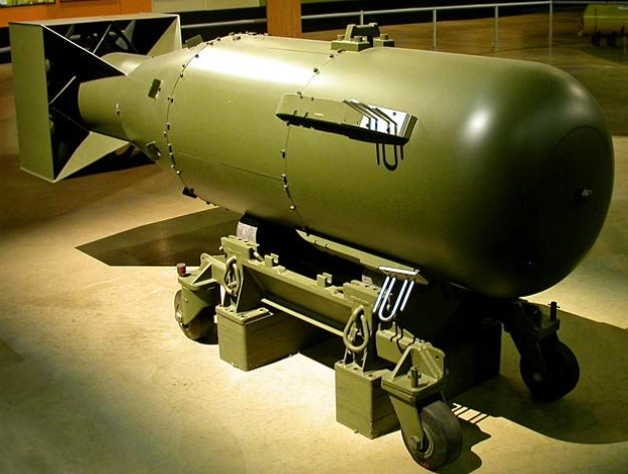
Description of Little Boy :
Type : Nuclear Weapon
Place of Origin : United States
Designer : Los Alamos Laboratory
Production Period : 1945
No. of Bombs Built : 26
Mass : 4,400 Kg
Length : 10 feet (3.3 m)
Diameter : 28 inches (71 cm)
Filling : Uranium-235
Filling Weight : 64 Kgs
Blast Yield : 15 Kilotons of TNT(63 TJ)

Slide 7
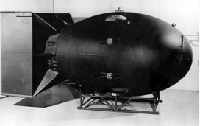
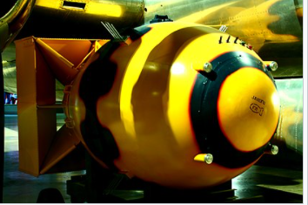
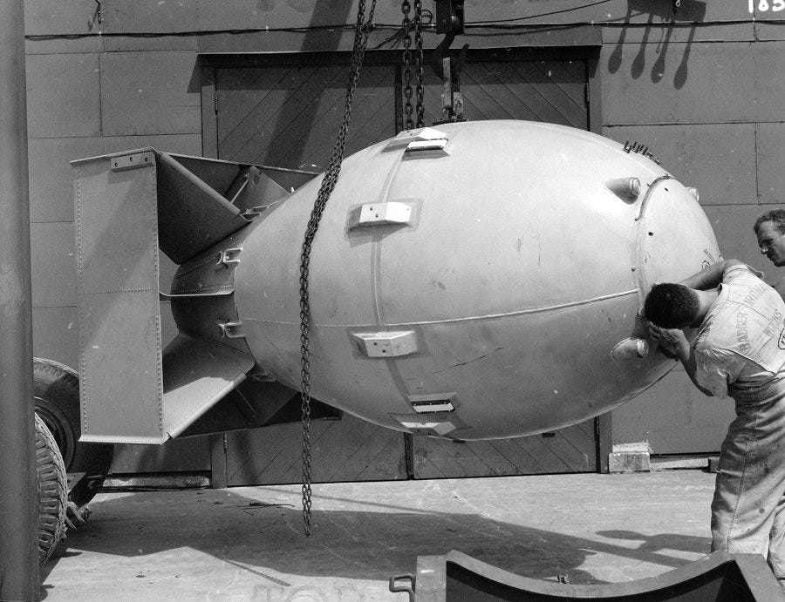
Fat Man
“Fat Man” was the Name of the Atomic Bomb dropped by America on Nagasaki.
Designer : Los Alamos Laboratory
Production Period : 1945 - 1949
No. of Bombs Built : 120
Mass : 4,670 Kg
Length : 28 inches (3.3 m)
Diameter : 60 inches (1.5m)
Filling : Plutonium
Filling Weight : 6.4 Kgs
Blast Yield : 21 Kilotons of TNT(88 TJ)

Slide 8
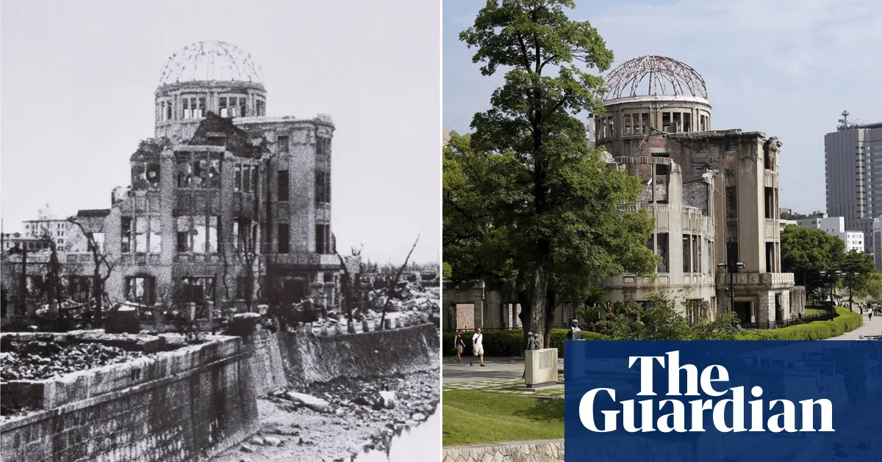
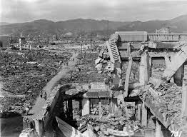
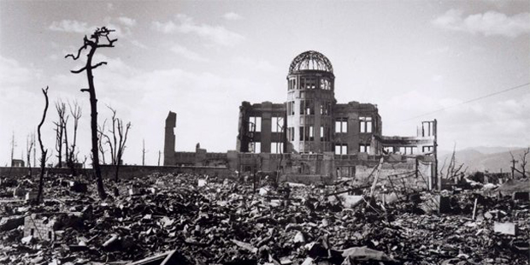
Preparation :
The consent of the United Kingdom was obtained for the bombing, as was required by the Quebec Agreement, and orders were issued for atomic bombs to be used against Hiroshima, Kokura, Niigata and Nagasaki on July 25.
On August 6, the B-29 Enola Gay dropped a Little Boy on Hiroshima, an embarkation port and industrial center that was the site of a major military headquarters.
Three days later, to take advantage of favorable weather, the B-29 Bockscar dropped a Fat Man on Nagasaki, a major military port, one of Japan's largest shipbuilding and repair centers, and an important producer of naval ordnance.

Slide 9
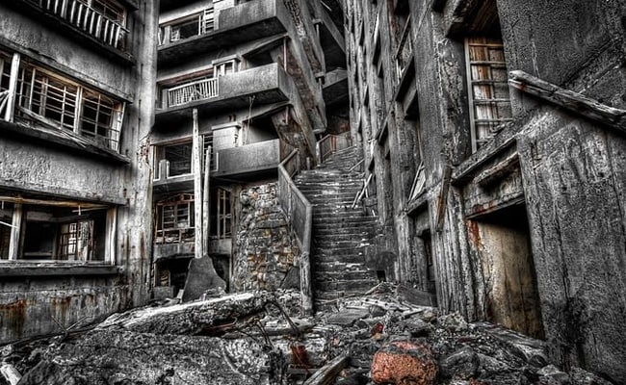
After Effects :
Over the next two to four months, the effects of the atomic bombings killed between 90,000 and 146,000 people in Hiroshima and 39,000 and 80,000 people in Nagasaki; roughly half occurred on the first day.
For months afterward, most of the dead were civilians, although Hiroshima had a sizable military garrison.
Japan surrendered to the Allies and World War II finally came to an end .

Slide 10
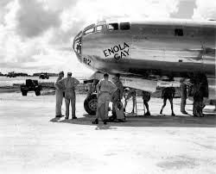
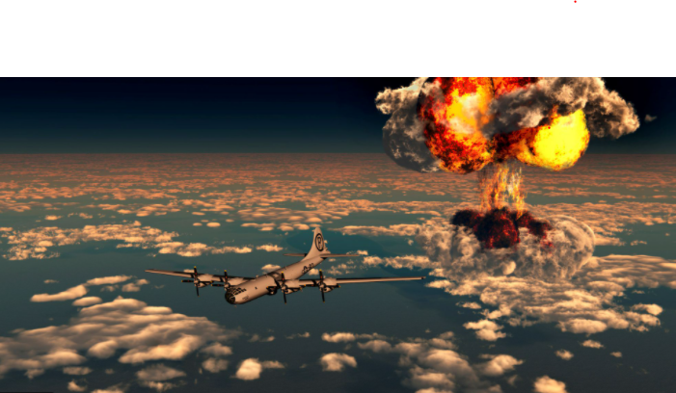
Why did the US drop atomic bombs on Hiroshima and Nagasaki?
First, it was to bring the war with Japan to a speedy end and spare American lives.
It has been suggested that the second objective was to demonstrate the new weapon of mass destruction to the Soviet Union.

Slide 11
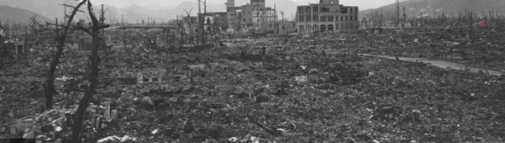
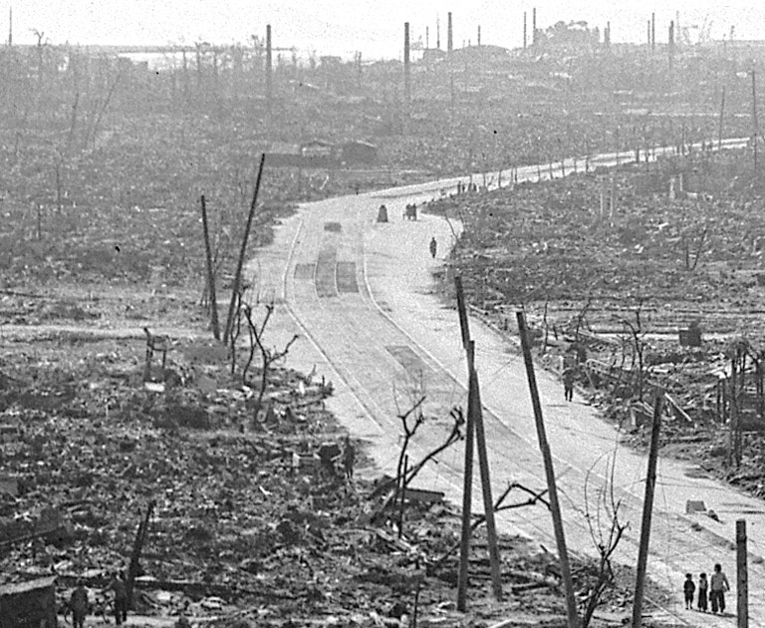
Was it Moral to use Atomic Bombs ?
The dropping of the atomic bomb on Hiroshima was justified at the time as being moral – in order to bring about a more rapid victory and prevent the deaths of more Americans
However, it was clearly not moral to use this weapon knowing that it would kill civilians and destroy the urban milieu.

Slide 12
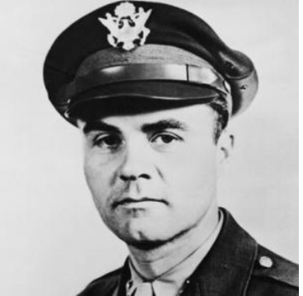
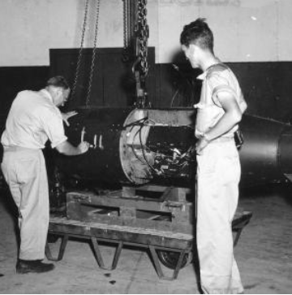
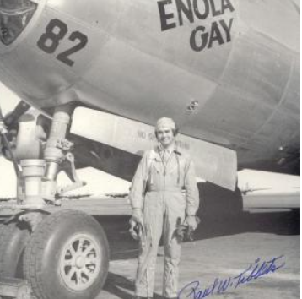
What about the inventors of the atomic bombs?
Robert Oppenheimer, the inventor of these atomic bombs, said years later that he regretted his invention.
Most of the hundreds of people who worked on this project had no idea about what they were working on.
Only a very few people at the top of the hierarchy knew what was being built.

Slide 13
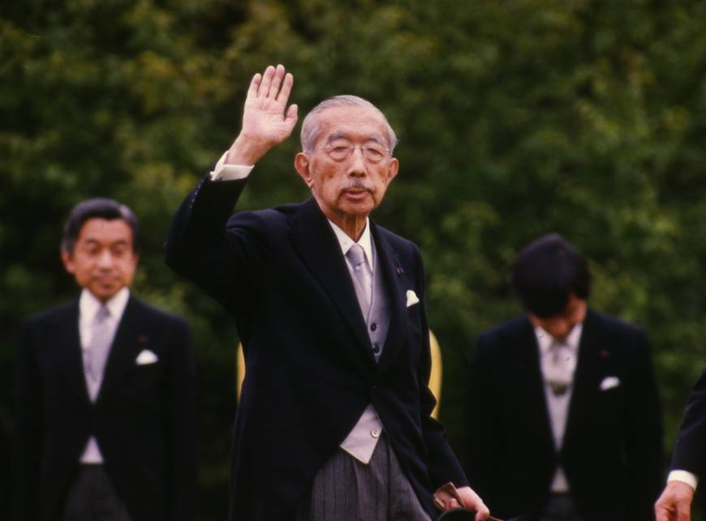
Did the Bombings Cause Japan to Surrender ?
Many historians say the bombings did not lead to the Japanese surrender, and the Soviet declaration of war on Japan two days later was a bigger shock.
Japanese historian Yuki Tanaka said the country had no choice because the Soviets would have killed Emperor Hirohito, seen as the heart and soul of imperial Japan.

Slide 14
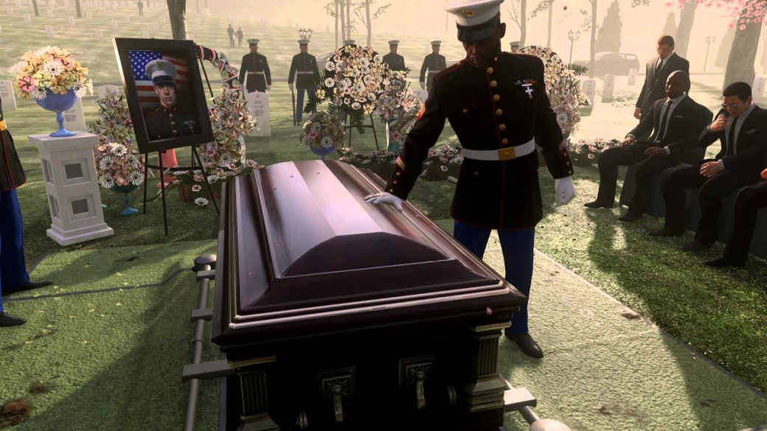
Thank You.
“Never think that war, no matter how necessary, nor how justified, is not a crime.” — Ernest Hemingway.

